Slide 1
Classes
Part 2
Creative Commons Attribution-NonCommercial-ShareAlike 3.0 Unported License. http://creativecommons.org/licenses/by-nc-sa/3.0/
Written by Rachel J. Morris, last updated 2016-02-06

Slide 2

We've covered some basics of classes,
But let's also talk about some more intermediate topics.
There are a lot of features for classes in programming, so you need to get a good handle of these topics.
Classes are the backbone of languages like C++, C#, and Java.

Slide 3

Constructors &
Destructors

Slide 4
Constructors & Destructors
Constructors and Destructors are a special type of function that classes can have.
Constructors are run automatically and immediately once you instantiate (declare) a variable of that object type.
Destructors are run automatically and immediately once that variable goes out of scope – in other words, just before it gets destroyed.
These are good for initializing and de-initializing our objects.

Slide 5
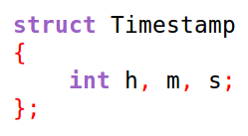
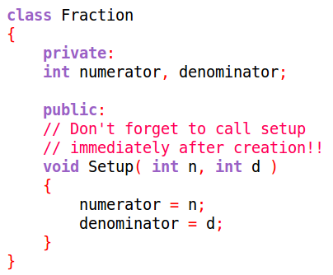
Constructors & Destructors
Remember how uninitialized variables may contain garbage? There is no default value for variables in C++.
If your class contains ints, floats, chars, or other data types as member variables, we don't know what they will store when the object is first created.
When we declare our object, we have to remember to initialize all its internal member variables.
Relying on “remembering” is a good way to get bugs, because somebody is going to eventually forget!

Slide 6
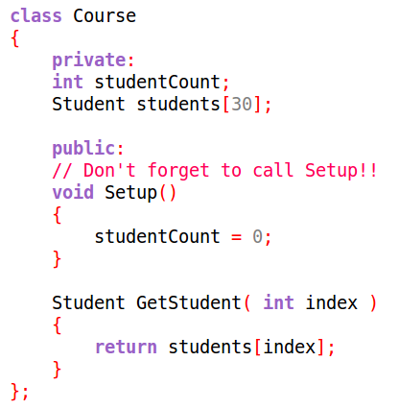
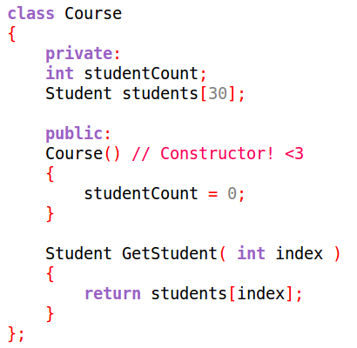
Constructors & Destructors
Using constructors means that we
DO NOT HAVE TO REMEMBER!
We can make sure the class initializes its member variables to some “safe” value...

Slide 7
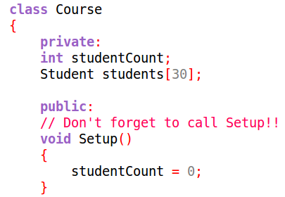
Constructors & Destructors
Relying on the user, another programmer, or even yourself to call the Setup() function after creating an object is very unreliable.
With this Course class, if studentCount is not initialized, it may store a garbage value (any number!), which means when we try to access the array, we might go outside of it's declared size!

Slide 8
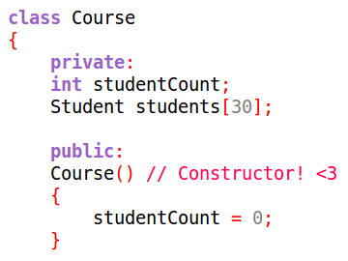
Constructors & Destructors
Relying on the user, another programmer, or even yourself to call the Setup() function after creating an object is very unreliable.
With this Course class, if studentCount is not initialized, it may store a garbage value (any number!), which means when we try to access the array, we might go outside of it's declared size!
The constructor is called automatically, so any member variables that might cause problems can be initialized right off the bat!

Slide 9
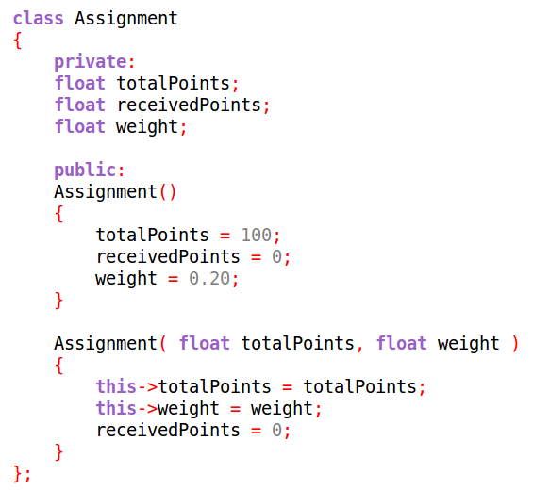

Constructors & Destructors
Additionally, you can also
overload your constructors
with different parameters,
to initialize your object differently based on what information is available when it is declared...

Slide 10
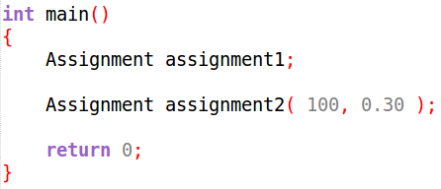
Constructors & Destructors
If a variable of this type Assignment is declared like assignment1, the constructor with no parameters is called, and everything receives a default value.

Slide 11
Constructors & Destructors
If we declare a variable of type Assignment, but pass in arguments, the constructor with the matching argument types will be called instead.

Slide 12
Constructors & Destructors
Note that if we had
Assignment( float totalPoints, float weight )
But not
Assignment()...
When we declare our object, it must have parameters, and would not accept a declaration without the parameters.

Slide 13
Constructors & Destructors
With Destructors, there can only be one – it does not take any parameters like a constructor can.
Destructors are called when the object variable goes out of scope and is destroyed.
This is especially useful once we get into memory management.

Slide 14
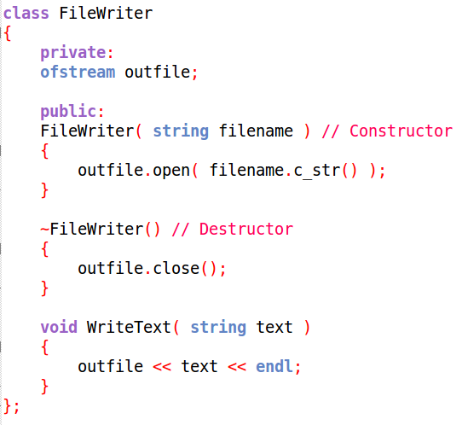
Constructors & Destructors
A good example of something we would want to clean up before an object is destroyed would be
File I/O!
With this class, it requires that you pass in a file name to open a file when the object is created.
When the object is destroyed, it closes the output file stream automatically, so we don't have to worry about it.
If we had forgot to close the file before the program quit, we could get corrupted data in our file.

Slide 15
Constructors & Destructors
The constructor always has the name of the object, no “return type”, and it may or may not have a parameter list. (Still needs parenthesis, though)
The destructor always has the name of the object, but with a tilde (~) before-hand. Its parameter list is always empty.

Slide 16

Static Members

Slide 17

Static Members
Static members are an interesting feature of classes.
I had a hard time grasping them at first, but these days I use them relatively frequently for a very specific type of class.
It's up to you to use static members in a class or not, but let's go over what they are, and some uses for them.

Slide 18
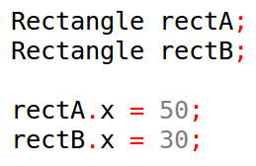
Static Members
With normal member variables, every time you instantiate (create) a variable of that object type, it gets its own set of those variables.
But if you declared a member variable as static, that variable would be shared among ALL instantiations of that object.
This might be useful for keeping count for all instances of the object,
Or something else that they all have in common.

Slide 19
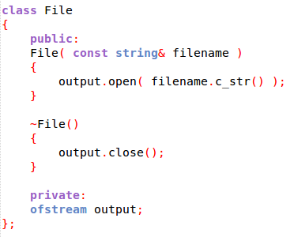
Static Members
OK, stay with me for a second.
Let's say that we're writing a class that “wraps” the file stream object from the standard library.
We want to take advantage of constructors and destructors to make sure the file is opened and closed safely, automatically.
File opened when object is created
File closed when object is destroyed
This object “wraps” ofstream to add functionality.

Slide 20
Static Members
Show programming

Slide 21
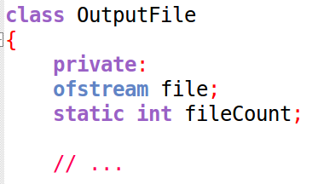
Static Members
So, we created a static member variable by adding the static keyword before the variable declaration.
Any time fileCount is accessed within any OutputFile function call, the values will be the same.
We initialize it at 0, and any time we add or subtract, that value is shared between all OutputFiles.

Slide 22
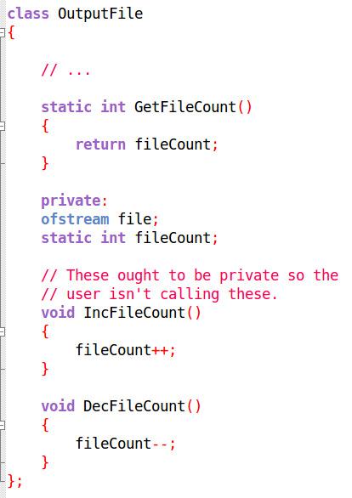
Static Members
We created some static functions as well.
Though I've adjusted this to be designed better.
If we want to call a function without creating any instances of this class, we want to make it static.
Otherwise, normal functions will do. These two are only accessed within OutputFile, so they've been made private and not-static.

Slide 23
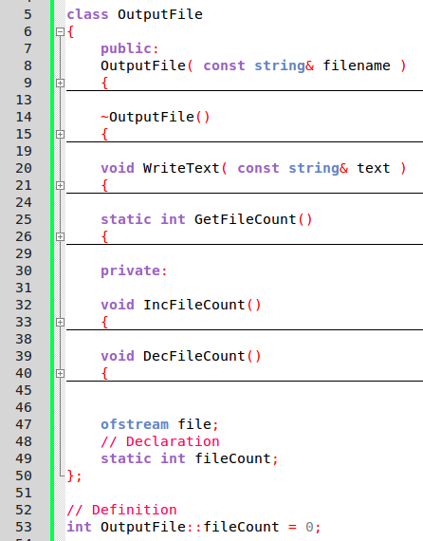
Static Members
With static members, we also have to define the variable, in addition to declaring it.
Outside of the class, we define it by specifying the
Data type,
Class it belongs to,
And variable name.
We can also initialize it here.

Slide 24
Static Members
When accessing a static member, we can either access it via the object name directly:
Or we can access it via an instantiation of the object:
This function returns the value of the static int fileCount,
So calling it either way will give us the appropriate value.

Slide 25
Static Members
It is good to know about static members,
Even if they don't make complete since right now.
As with anything, it takes practice.
And if you encounter a static member in somebody else's code, you have a rough idea of how it works.

Slide 26

Const Functions

Slide 27
Const Functions
We have used the const keyword in the past to create a variable flag that doesn't change, as well as to create function parameters that are guaranteed to not change.
We can also ensure that an object's member function cannot change the value of member variables
by marking the function as const.

Slide 28
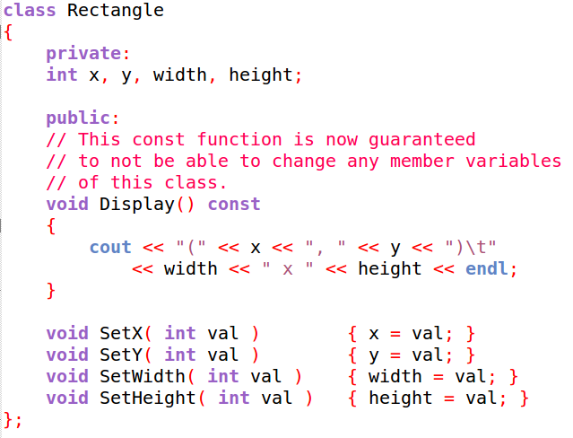
Const Functions
If we put const at the end of our function signature,
this means that within the function, no members of the class will change their values.

Slide 29
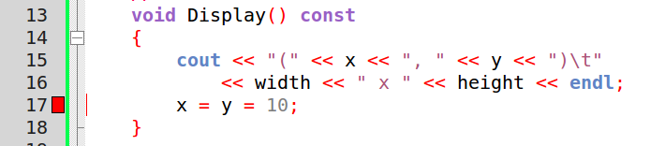
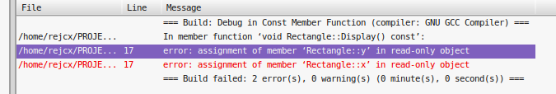
Const Functions
Similar to passing values by reference but not wanting those values to change, const lets us write functions that operate on some data, but does not “corrupt” that data in the process.
Trying to make a modification within a const function will result in a build error.
It is always easier to fix a
build error than a logic error!

Slide 30
How are you doing with classes?
We've covered a lot of important topics!
How about this time, I give you some practice problems to solve?
You'll find the solutions in the course repository.

Slide 31
Class “Homework”
#1
Write a program that has a struct called CoordPair.
CoordPair has the following member variables:
x and y, both floats.
And the following member functions:
GetUserInput(), return type void, which has the user input values for the x and y member variables.
Display(), return type void, which displays the x and y values as a coordinate pair, like this: (2, 3)
Test it out by creating some CoordPair objects within main(), having the user enter both, and finding the slope between these coordinate pairs.
Remember that structs make their members public by default!

Slide 32
Class “Homework”
#2
Write a program that has a class named Student.
Member variables (private):
name, type string
classNames, array of size 3, strings
Member functions (public):
void SetName( const string& value ) - set the name member to the value passed in.
void SetClassName( int index, const string& value ) - set the name of the class at index index to the value passed in.
void DisplayInfo() - Display the student name and all 3 class names.
In main, create a few students, set their names, and all of their classes. Then use DisplayInfo() to view all the information.

Slide 33
Class “Homework”
#3
Write a program that has a class called MyClass. It has the following public members:
MyClass() constructor – output the text “Constructor”
MyClass( const string& value ) constructor – Output the text “Constructor”, then the value of the parameter.
~MyClass() destructor – Output the text “Destructor”
int main()
{
MyClass classA;
if ( true )
{
MyClass classB( "B!" );
MyClass classC;
}
return 0;
}
In main, create a series of MyClass objects to see the constructors and destructors working.

